Slide 2
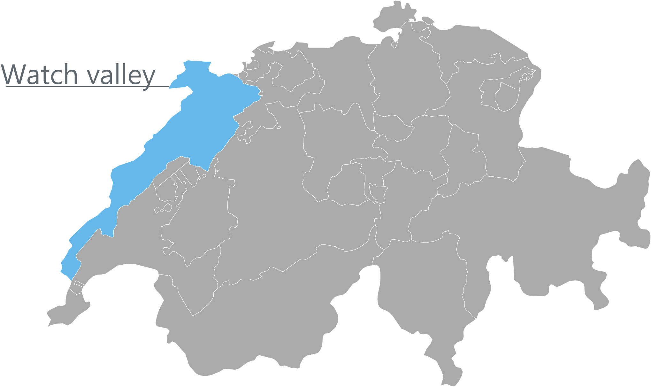
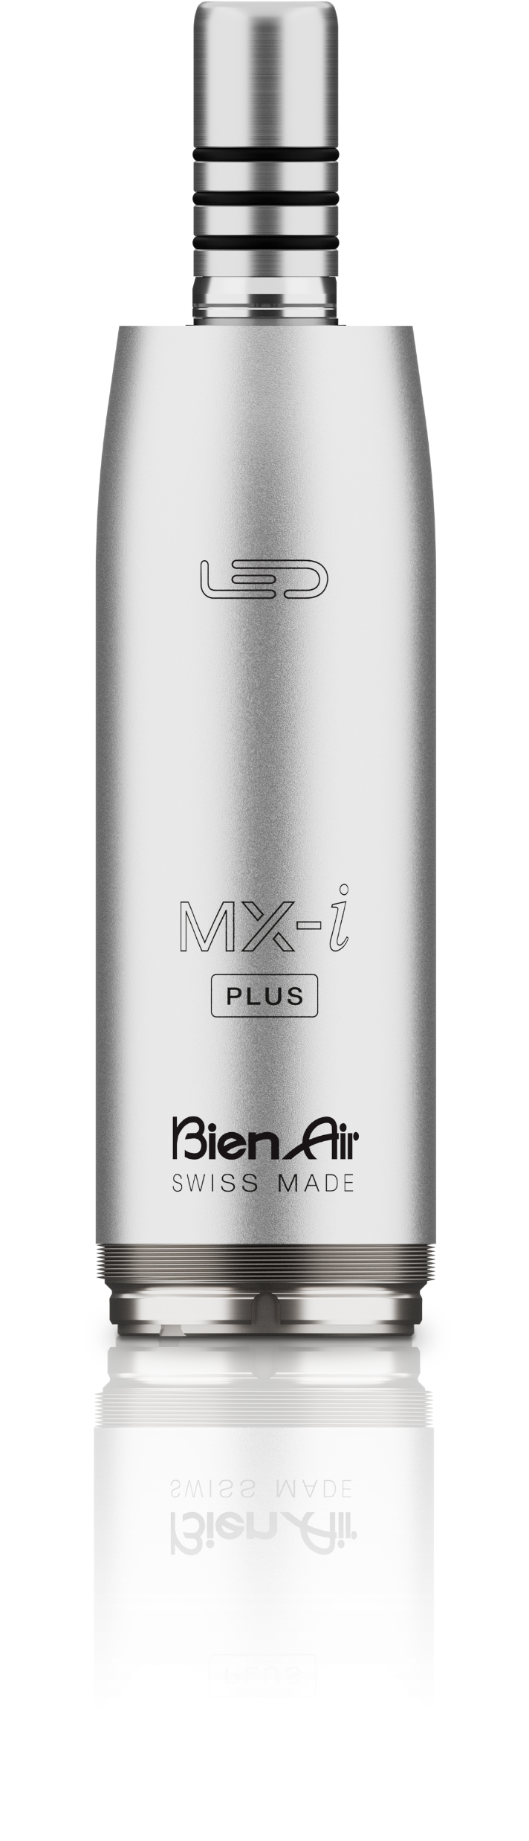
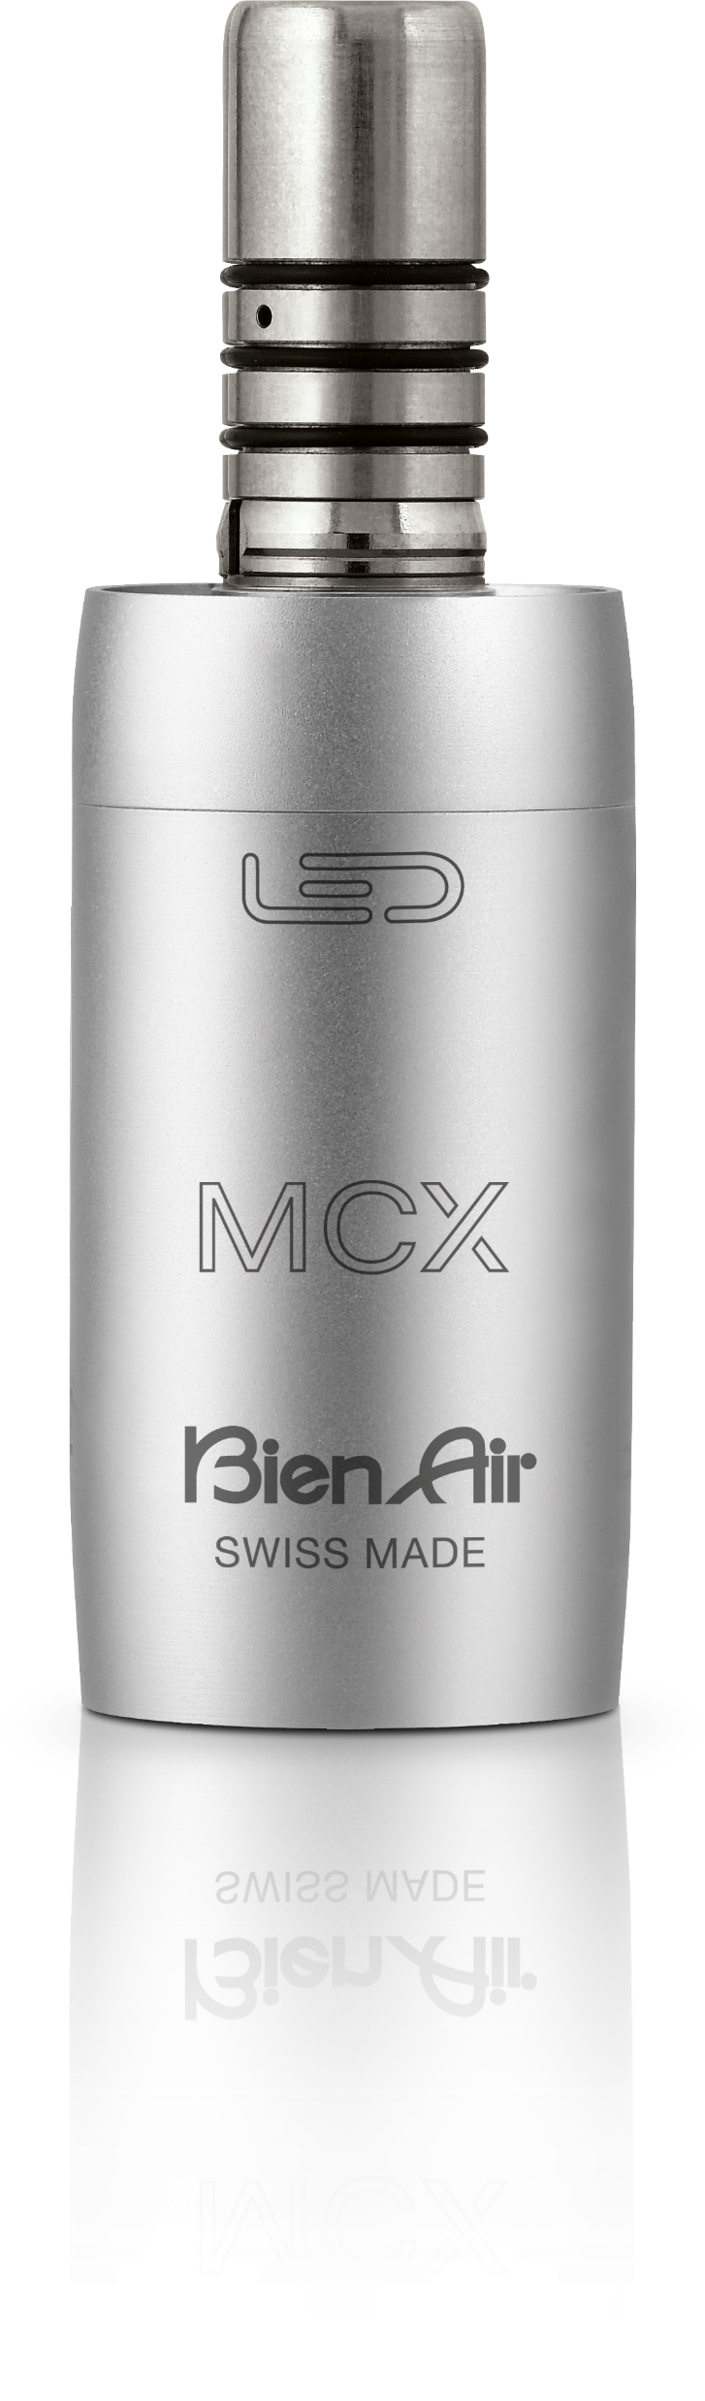
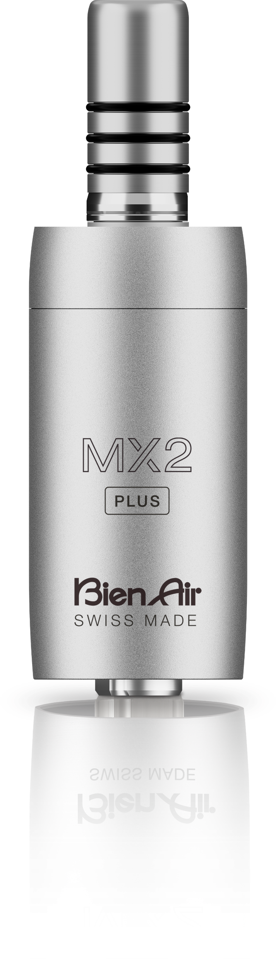
About
Located in the Swiss region known for
precision watchmaking
World’s largest manufacturer of electric motors for dental applications
67,000 motors produced annually

Slide 3

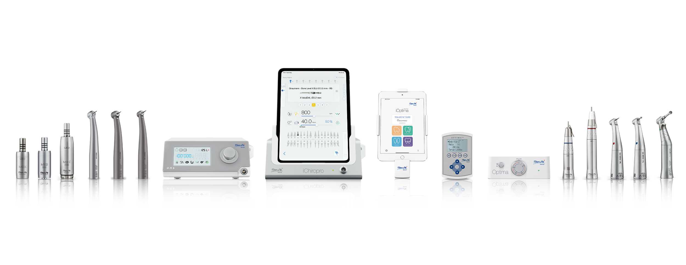
Product Range
Implantology & Surgery
Electric Attachments
Air-Driven Handpieces
Electric Systems

Slide 4
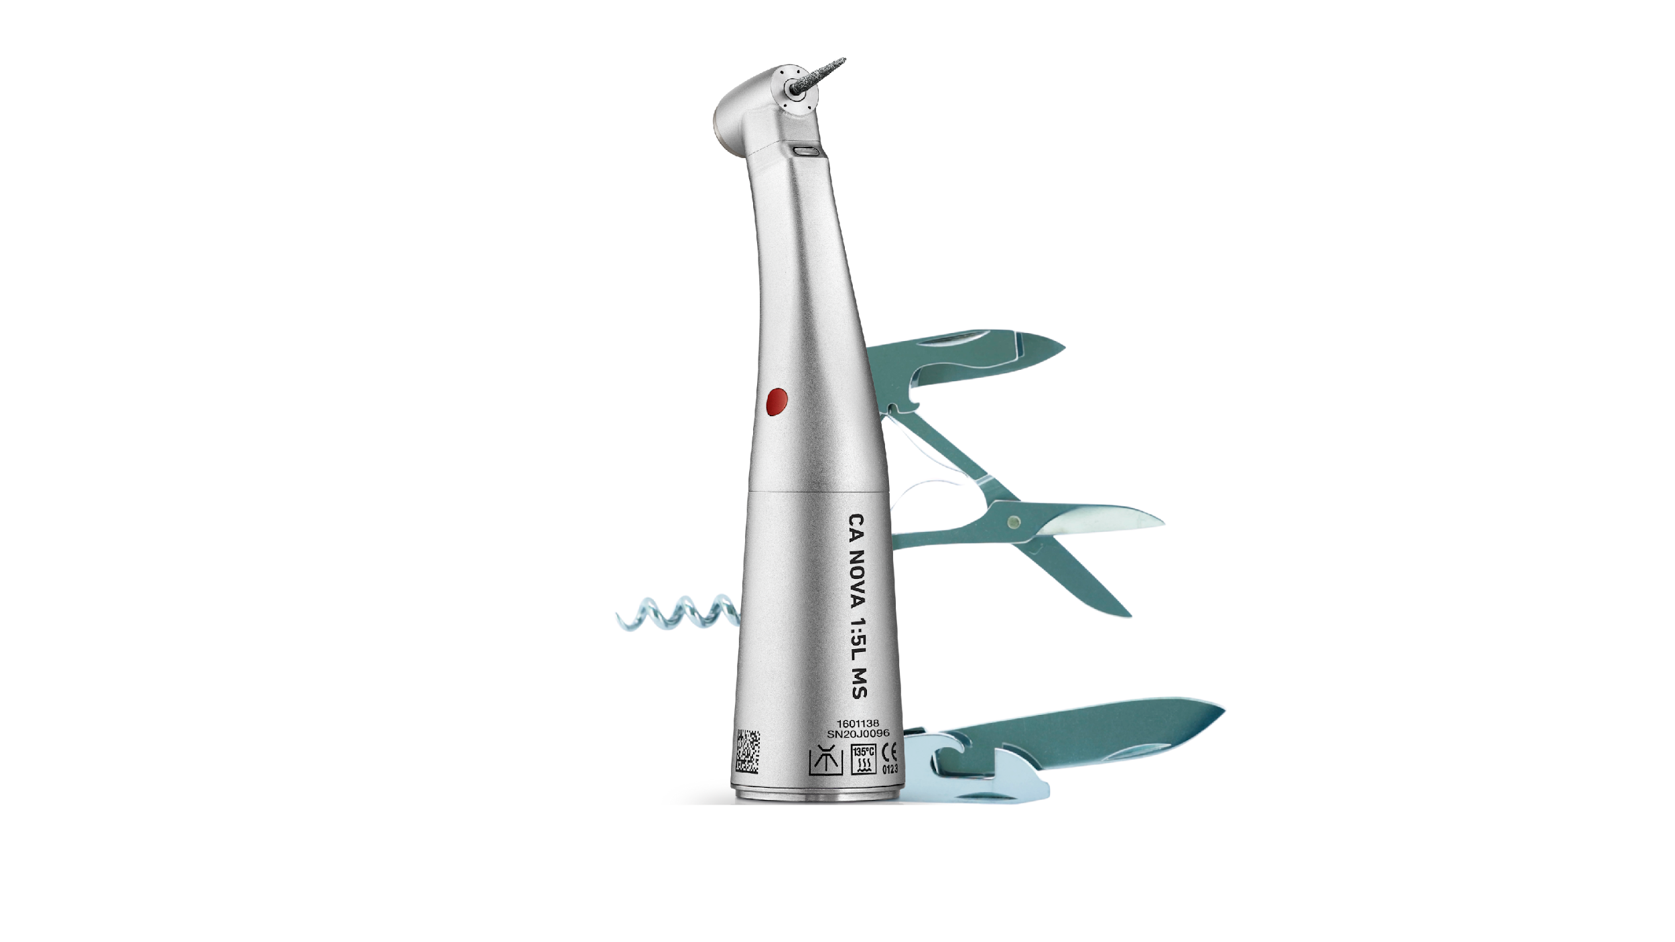


Why Bien-Air?
Operatory ROI
  High Speed Red (CA NOVA 1:5) is the “All Speed” handpiece.
  Reduces inventory by decreasing number of handpieces needed per procedure.
  Increases operatory efficiency, less time per chair.

Slide 5
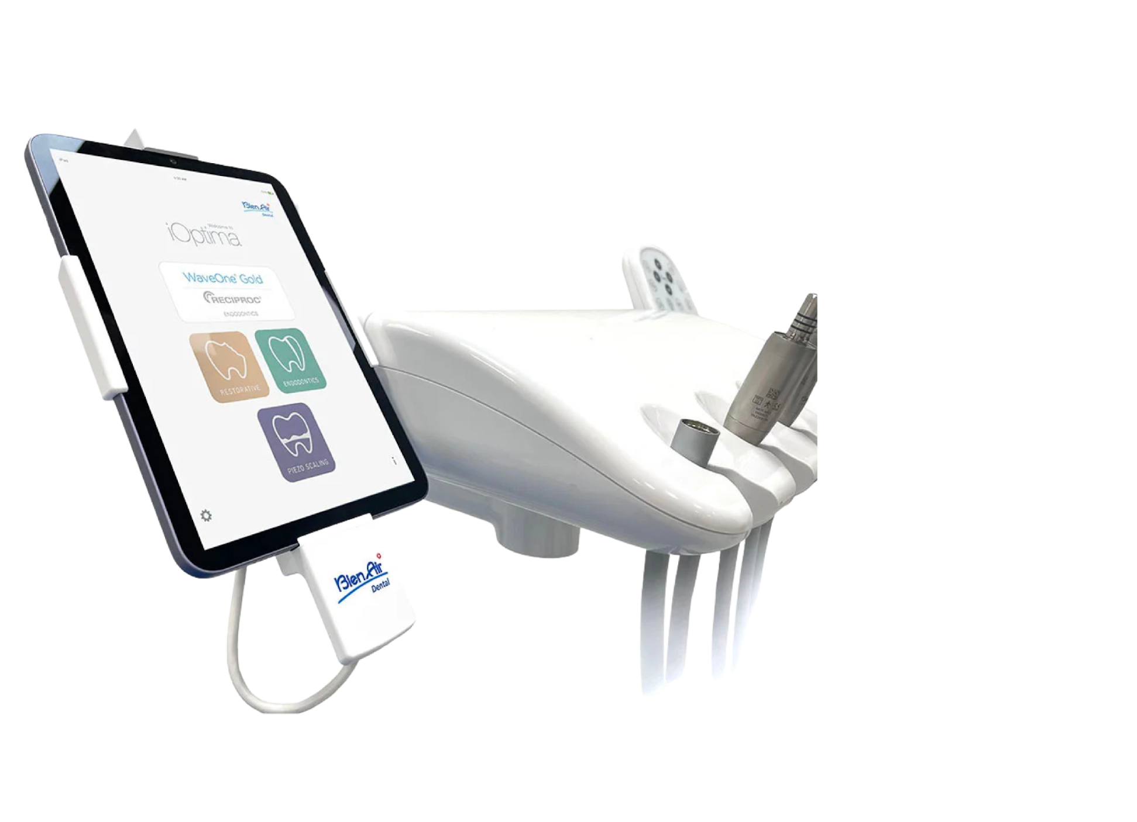
Why Bien-Air? (Cont)
Full Integration
  All Bien-Air systems seamlessly integrate into any existing dental unit.
  Less connections, tubes, and wiring, means less repairs over time.
  Simplifies the user-experience, saving you time for every procedure.

Slide 6
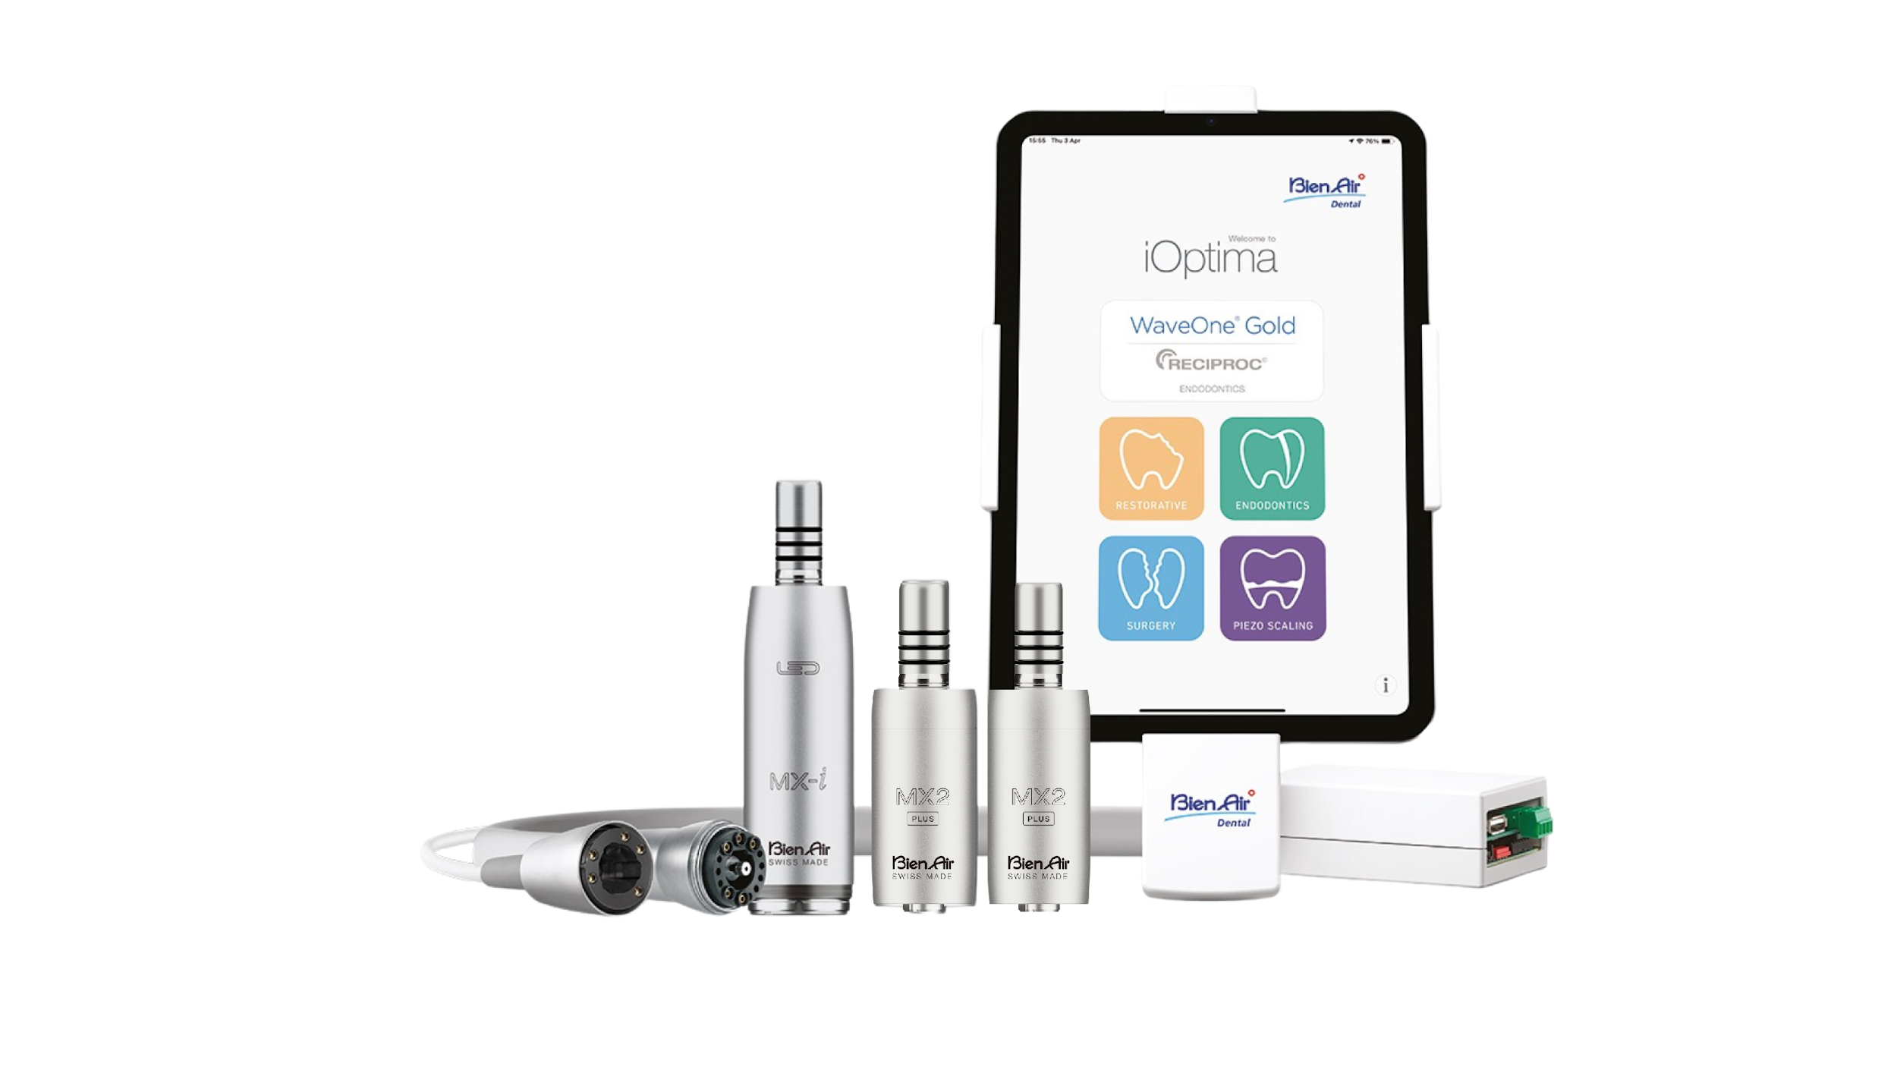

Why Bien-Air? (Cont)
All-in-One Solution
  The iOptima^{INT} turns every restorative operatory into a multi-specialty operatory.
  Increases the potential revenue for each operatory.
  Increases scheduling opportunities for specialty procedures.

Slide 7
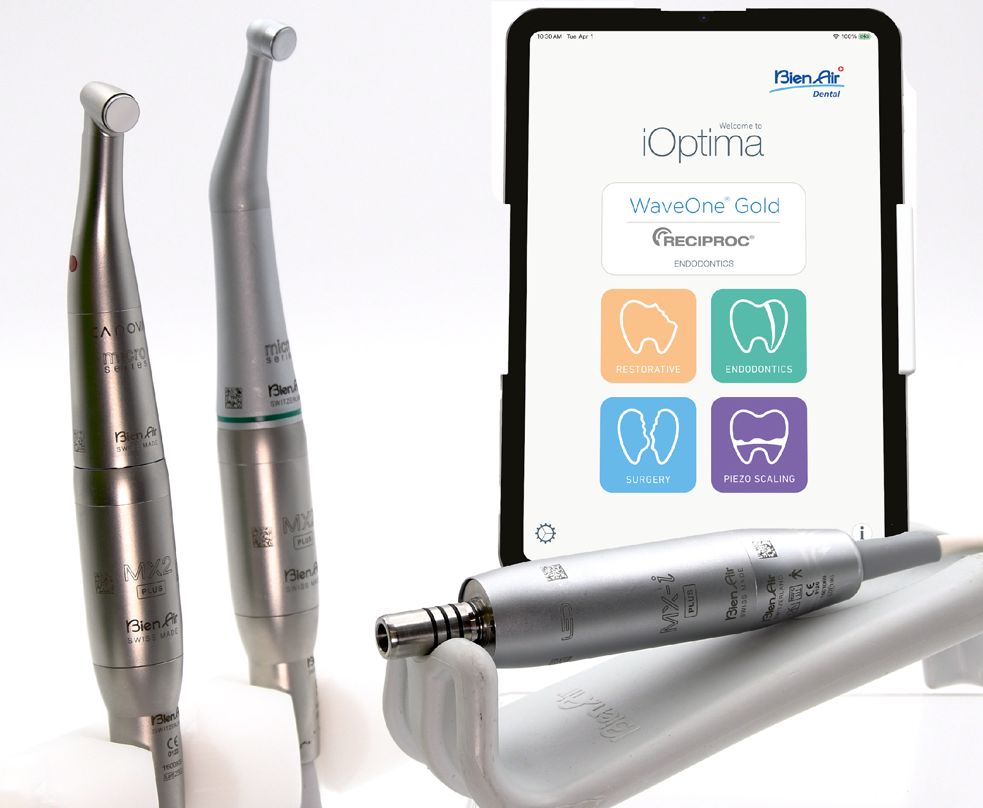
Why Bien-Air? (Cont)
Electric Made Easy
  Our products make the barrier for entry into electric minimal, regardless of the size of your practice.
  Electric Advantage Program alleviates major pain points in emerging markets.
  Our products simplify the working life of a dentist.
  Bien-Air offers multi-specialty systems, allowing for Endodontic & Surgical procedures, chairside.

Slide 8



Why Bien-Air? (Cont)
Aggressive Promotions
  We want a seat at the table when the doctor asks about handpieces and handpiece specials.
+
2 + 1 and 3 + 2 options available on almost all handpieces!
+

Slide 9
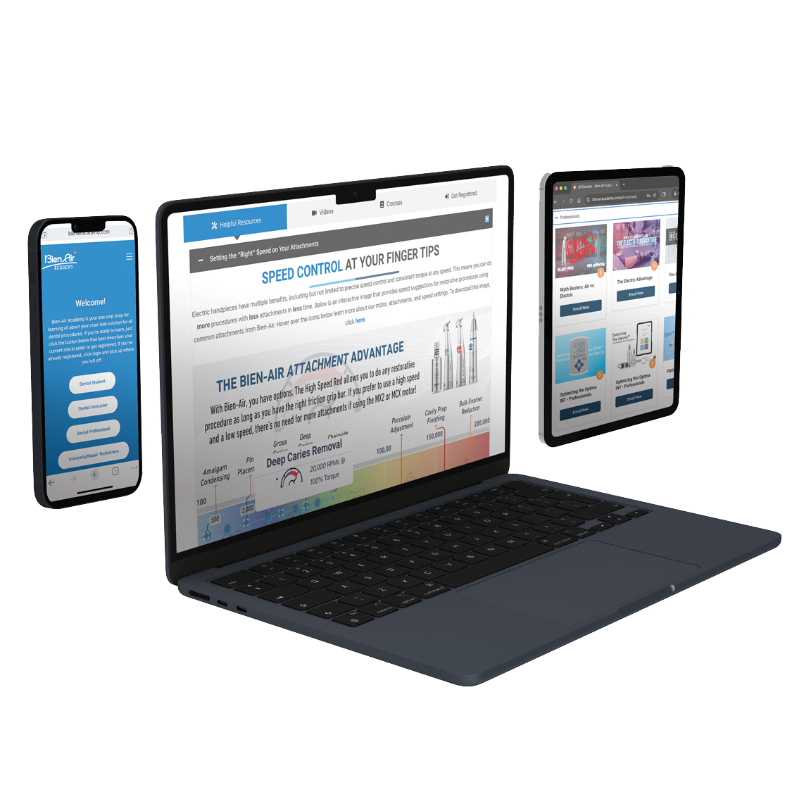

Why Bien-Air? (Cont)
Bien-Air Academy
  Free access to incredible educational resources tailored to all dental stakeholders, including CE courses!
  Take advantage of our free CE courses - Coming in 2026!
  Bien-Air gets you up to speed with our products quickly and efficiently!

Slide 10
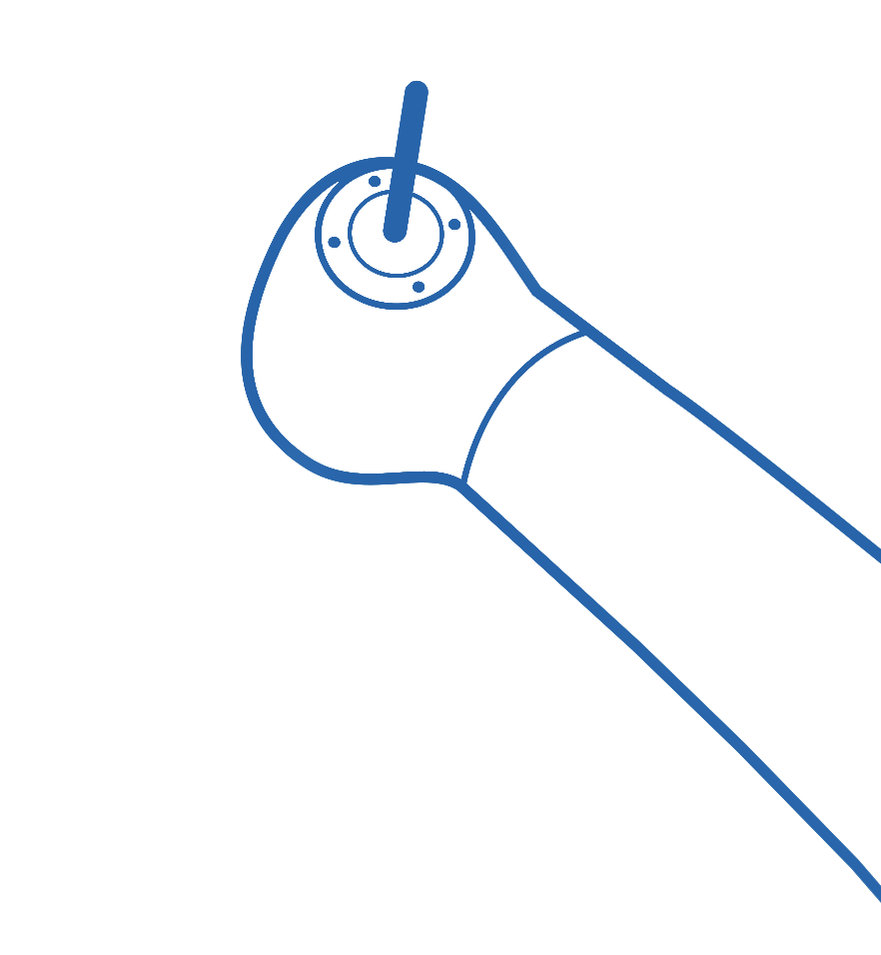

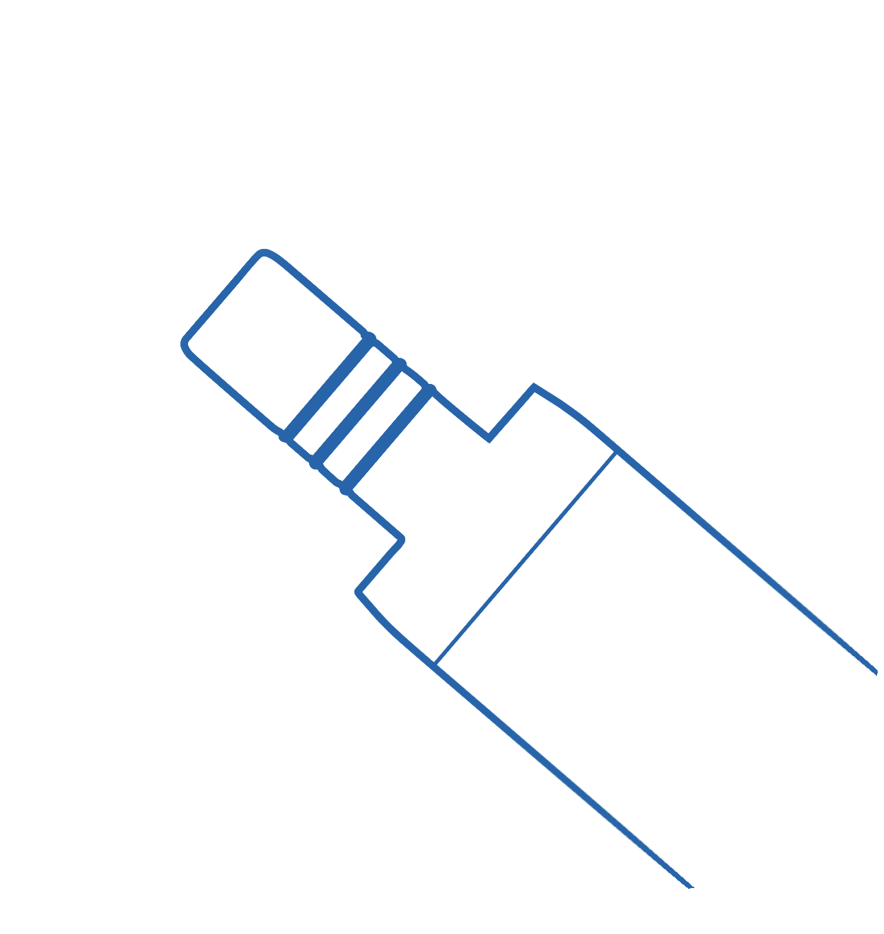

Slide 11

Ideal Candidates
  3+ Location Emerging
  Market Groups
  Air Handpiece Costs Exceeding Budget
  Interest in Electrics + Desires a Fixed Cost + Multi-Specialty

Slide 12



Imagine the Advantage…
  Free Installation
  Fixed Cost
  Free Repairs
  in all participating locations.
  per monthly calculator.
  through the term of the lease.
  At the end of agreement, you own the equipment.

Slide 13
Comments?
Questions?
Feedback?

