Slide 2
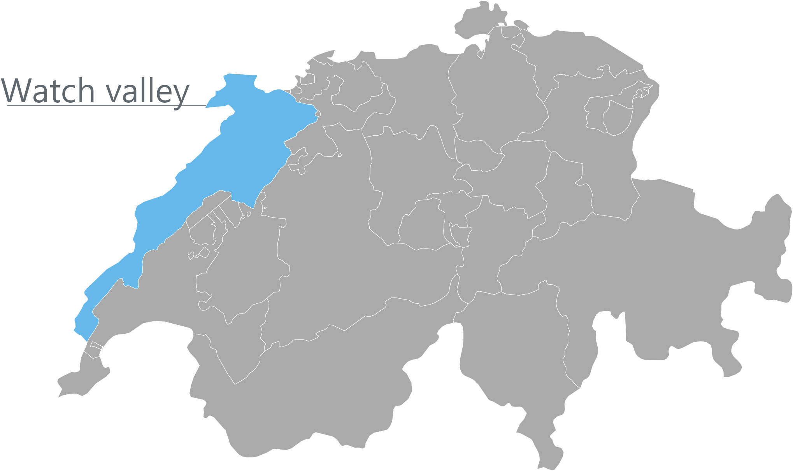
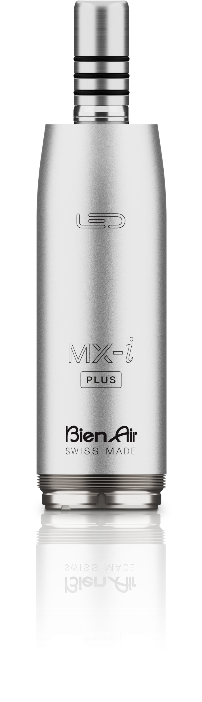
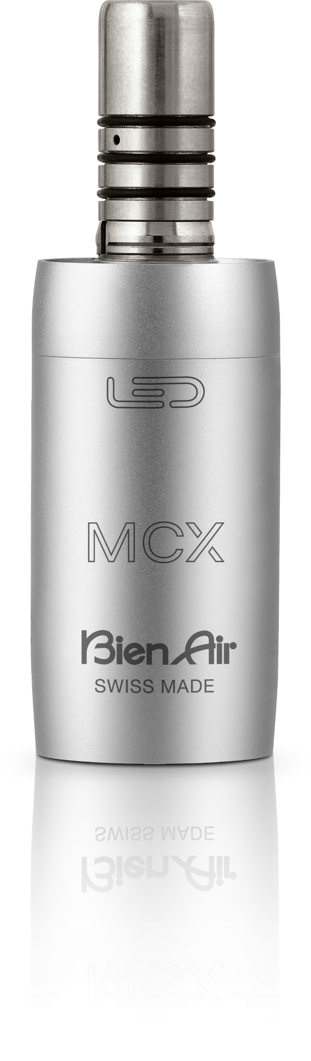
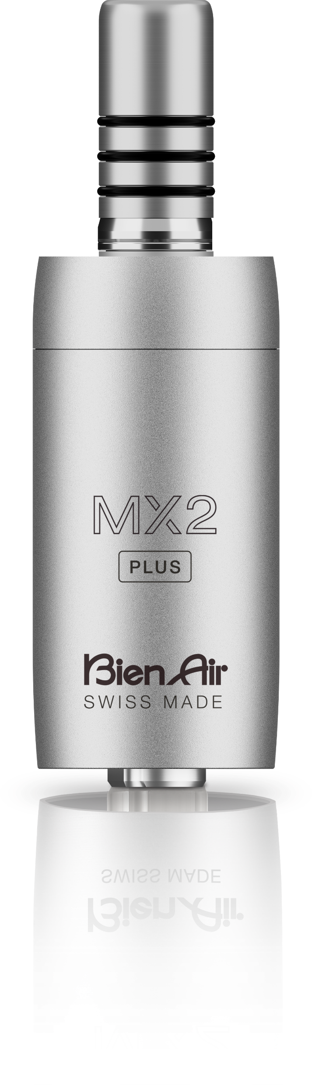
About
Located in the Swiss region known for precision watchmaking
World’s largest manufacturer of electric motors for dental applications
67,000 motors produced annually

Slide 3

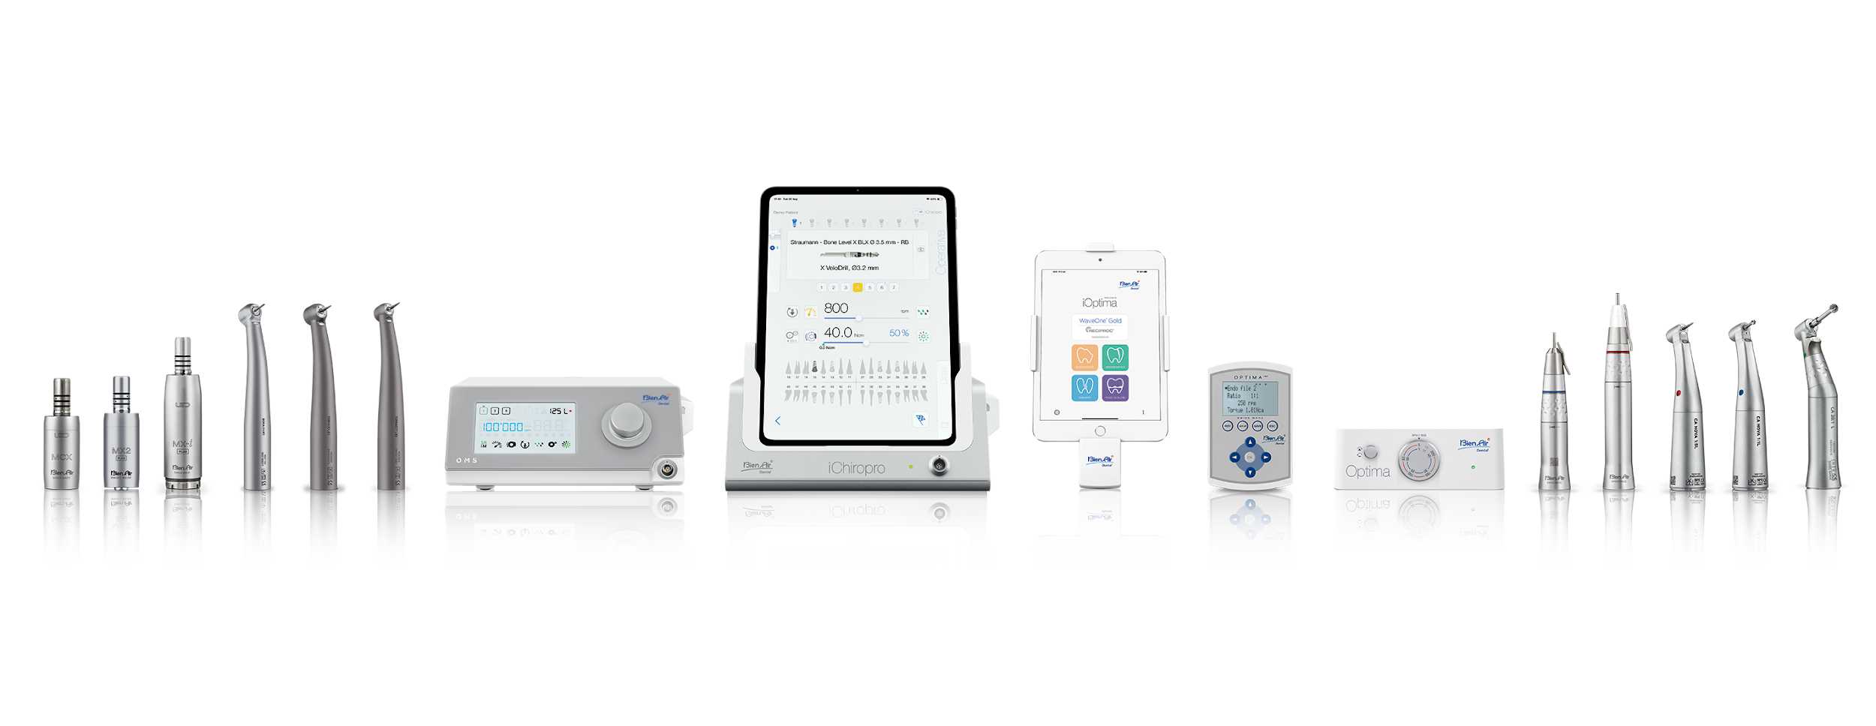
Product Range
Implantology & Surgery
Electric Attachments
Air-Driven Handpieces
Electric Systems

Slide 4
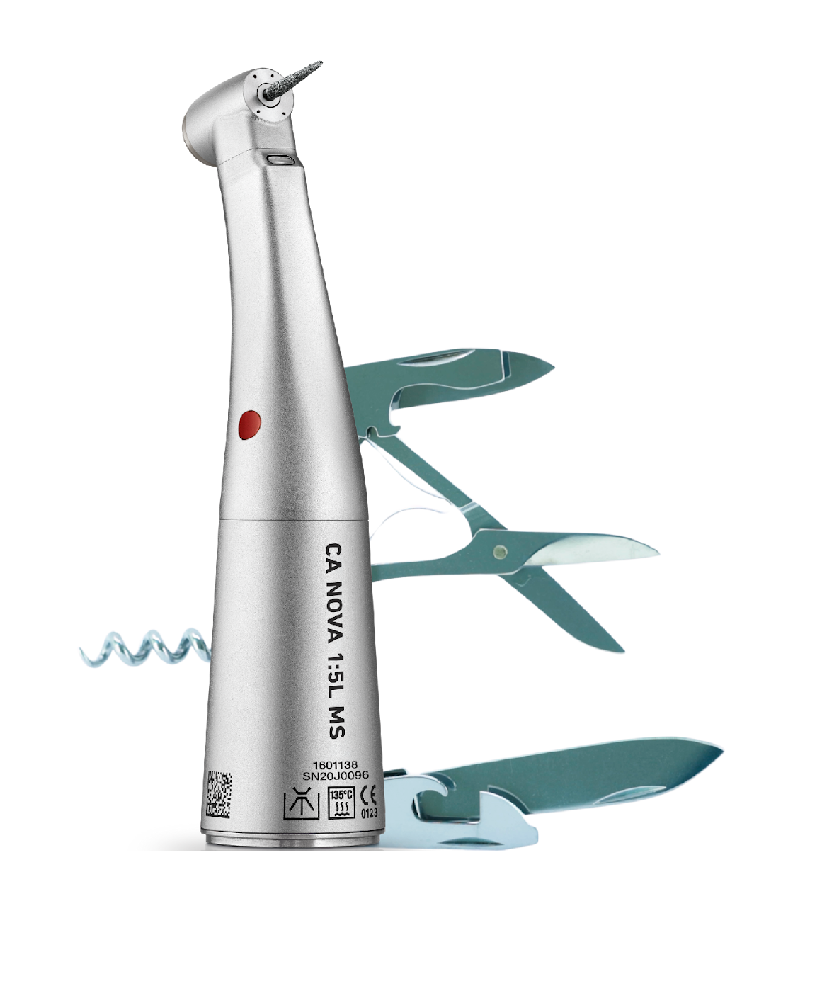


Why Bien-Air?
Operatory ROI
High Speed Red (CA NOVA 1:5) is the “All Speed” handpiece.
Reduces inventory by decreasing number of handpieces needed per procedure.
Increases operatory efficiency, less time per chair.

Slide 5
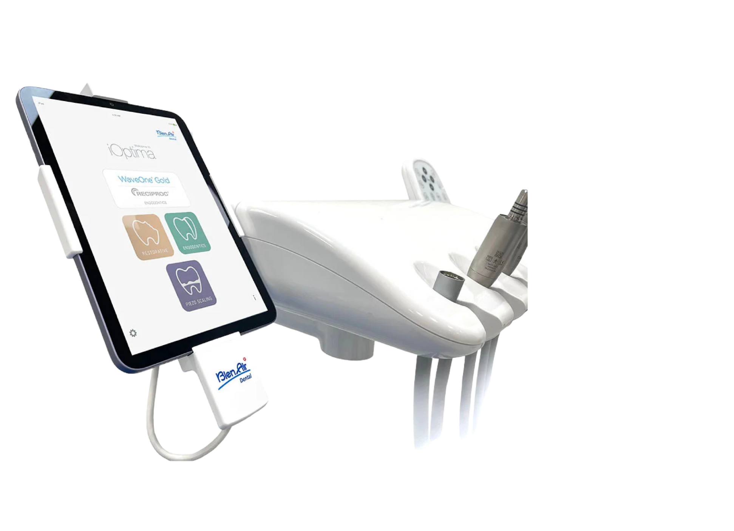
Why Bien-Air? (Cont)
Full Integration
All Bien-Air systems seamlessly integrate into any existing dental unit.
Less connections, tubes, and wiring, means less repairs over time.
Simplifies the user-experience, saving you time for every procedure.

Slide 6
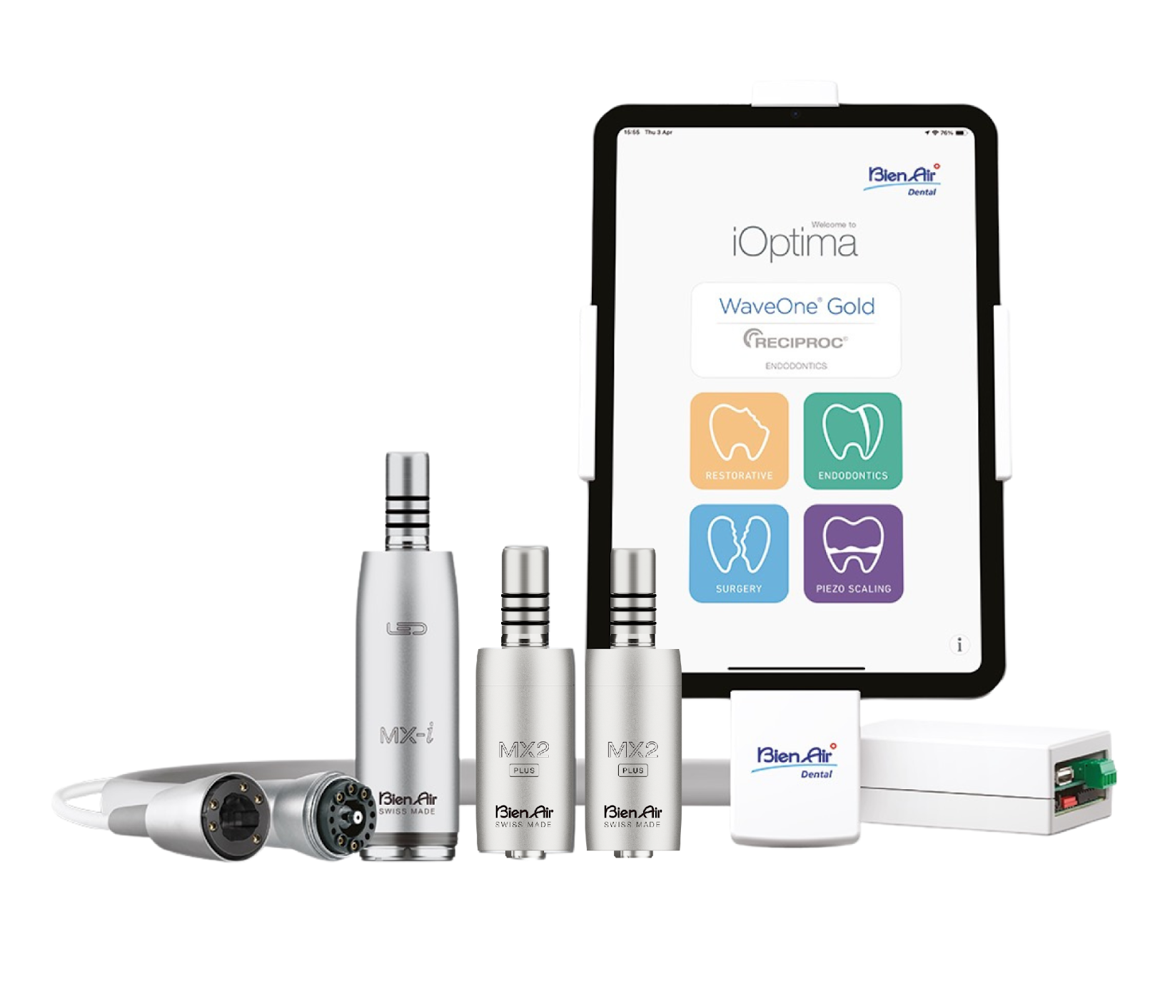

Why Bien-Air? (Cont)
All-in-One Solution
The iOptima^{INT} turns every restorative operatory into a multi-specialty operatory.
Increases the potential revenue for each operatory.
Increases scheduling opportunities for specialty procedures.

Slide 7

Why Bien-Air? (Cont)
Electric Made Easy
Our products make the barrier for entry into electric minimal, regardless of the size of your practice.
Electric Advantage Program alleviates major pain points in emerging markets.
The Electric Starter Package renovates an air-driven operatory in minutes.

Slide 8



Why Bien-Air? (Cont)
Aggressive Promotions
We want a seat at the table when the doctor asks about handpieces and handpiece specials.
+
Bundles with the Electric Starter Package!
+

Slide 9
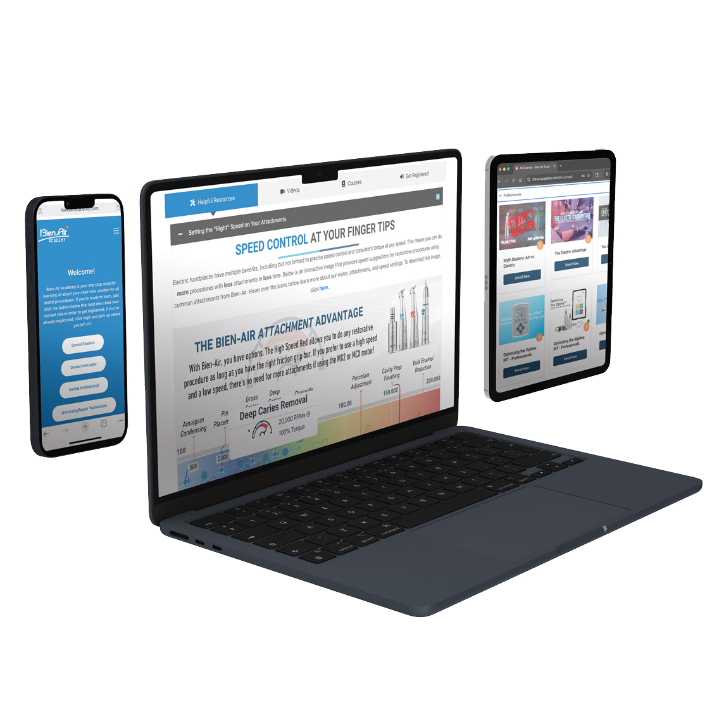

Why Bien-Air? (Cont)
Bien-Air Academy
Free access to incredible educational resources tailored to all dental stakeholders, including CE courses!
Take advantage of our free CE courses - Coming in 2026!
Bien-Air gets you up to speed with our products quickly and efficiently!

Slide 10
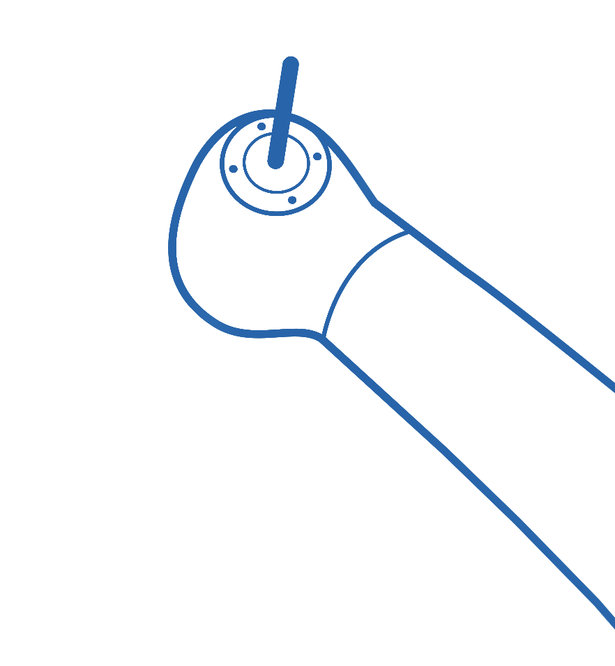



Slide 11

Ideal Candidates
3+ Location Emerging
Market Groups
Air Handpiece Costs Exceeding Budget
Interest in Electrics + Desires a Fixed Cost + Multi-Specialty

Slide 12



Imagine the Advantage….
Free Installation
Fixed Cost
Free Repairs
in all participating locations.
per monthly calculator.
through the term of the lease.
At the end of agreement, you own the equipment.

Slide 13
Comments? Questions? Feedback?

